Slide 1

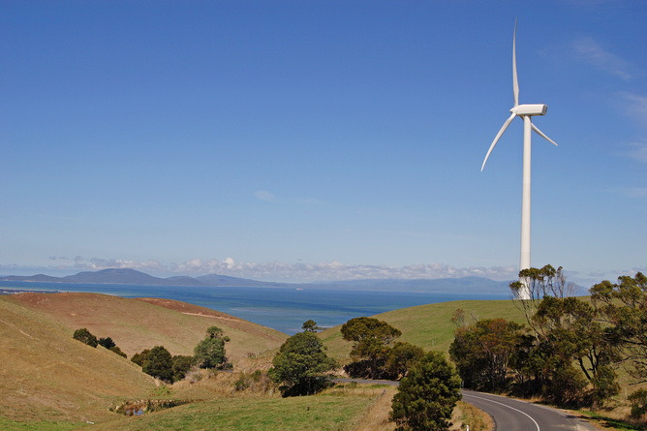
Forecasting Wind Power using Deep Learning
By : Amit Bharadwa

Slide 2
The Problem
The problem with renewable forms of energy is predicting intermittency.
The ability to forecast energy highs and lows can provide valuable intelligence to the grid.
The financial loss companies incur due to loss in power production.
Lowering the financial loss in turn lowers the cost for the consumer which provides a greater incentive towards renewable energy rather than coal/gas.

Slide 3
The Problem
Using the data provided from Kaggle on a wind turbine in Turkey, an accurate predictive model will be build using deep learning methods and to forecast the power output of the turbine over a two week period.

Slide 4
The Data
The data used for this project is of a single wind turbine in Turkey during the year of 2018.
Using a smart device, SCADA (Supervisory control and data acquisition) systems, data can be collected and aggregated into 10 minute intervals
Data source: https://www.kaggle.com/berkerisen/wind-turbine-scada-dataset
Features of the dataset include:
Date/Time - 10 min intervals
LV Active Power (kW) - Power generated by the turbine
Wind Speed (m/s) - Speed of wind at hub height
Theoretical Power (kWh) - Maximum possible power using the Betz Law
Wind Direction (°) - Direction of the wind at hub height

Slide 5
Data Wrangling & Feature Engineering
Observations with a wind speed greater than 3.3m/s and power output equal to zero is removed. Assuming under maintenance.
Remaining observations remain as the model will try to predict intermitency.
The data is resampled into hourly intervals and missing values are interpolated.
An addtional loss feature is added to the dataset: Theoriteical power – Actual Power.
A categorical feature is created for the wind direction. (E.g N, NE, ENE etc)

Slide 6
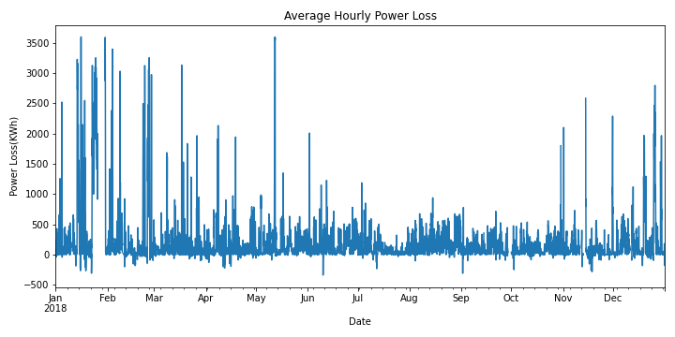
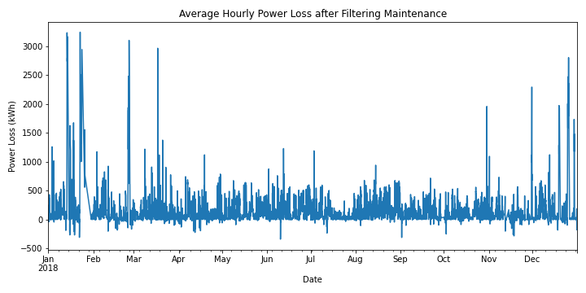
Figure 1:
LV active power before removing maintenance.
Figure 2: LV active power after removing maintenance.

Slide 7
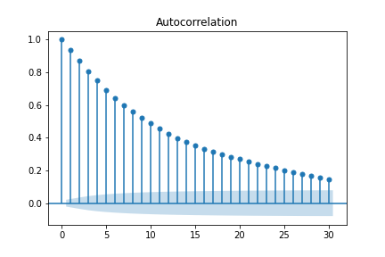
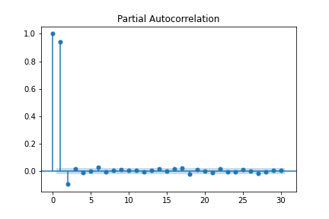
Figure 3 identifies the dependence of the pervious timestep on the next time step.
Figure 4 shows a lag of 1 has the most significance on the next time step.
An additional feature with a lag of 1 timestep (T_1) is added to the dataset.
Figure 3: Auto correlation function over hourly intervals for a 30 day period.
Figure 4: Partial auto correlation function over hourly intervals for a 30 day period.

Slide 8
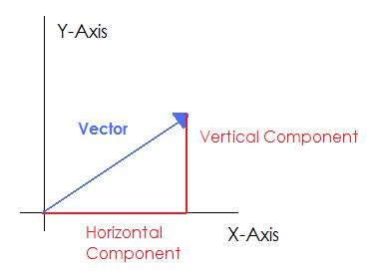
Two additional features are added to the dataset
Y compoenent of wind speed and direction:
Y = wind speed * Sin(wind direction in randians)
X component of wind speed and direction :
X = wind speed * Cos(wind direction in radians)
Figure 5: x and y compoenent of wind speed.
Wind direction in degrees and the categorical wind direction feature is only used for the exploratory data analysis part of the project. It is removed prior to modelling.

Slide 9
Proving Stationarity using adfuller test
Null Hypothesis (H0): If failed to be rejected, it suggests the time series has a unit root, meaning it is non-stationary. It has some time dependent structure.
Alternate Hypothesis (H1): The null hypothesis is rejected; it suggests the time series does not have a unit root, meaning it is stationary. It does not have time-dependent structure.
p-value > 0.05: Fail to reject the null hypothesis (H0), the data has a unit root and is non-stationary.
p-value <= 0.05: Reject the null hypothesis (H0), the data does not have a unit root and is stationary.
Feature | LV Power | Wind Speed | Theoretical Power | Loss | X component | Y component
P- value | 3.177e-29 | 4.828e-24 | 1.934e-29 | 1.084e-27 | 2.592e-23 | 3.203e-15
Table 1: Shows p-value for each feature using adfuller test.
All Features Statistically Significant

Slide 10
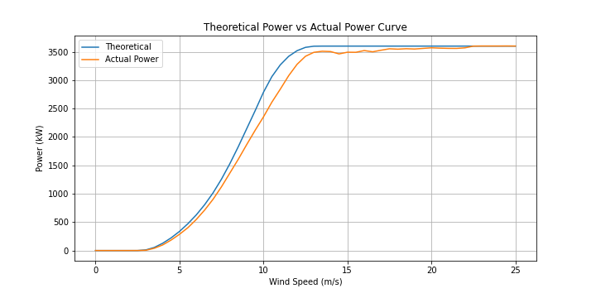
Exploratory Data Analysis
Figure 6: Showing the mean power with respect to the wind speed for the power produced compared to the Betz Limit.

Slide 11
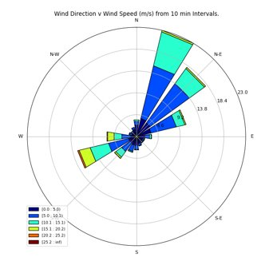
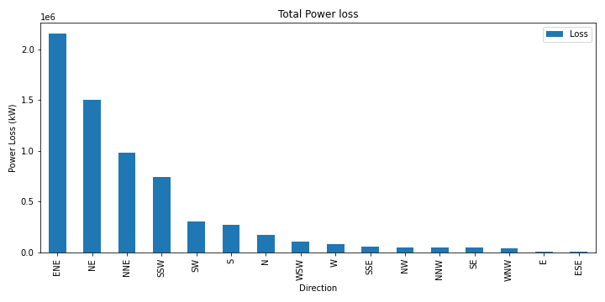
Figure 7: Showing the direction which the wind tends to blow towards
Figure 8: Showing the power loss of the turbine in each direction.

Slide 12
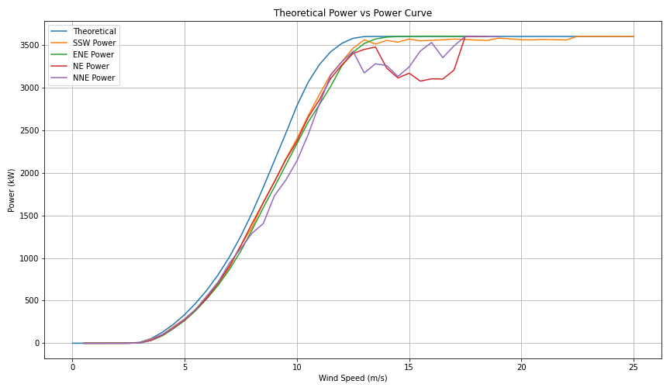
Fgiure 9 showing power loss in NE and NNE direction.
This would be worth investigating further with the operations and maintenance team
Figure 9: Showing the mean power with respect to the wind speed for the directions with the greatest power loss.

Slide 13
Co-integration test between LV power and other features
Null Hypothesis (H0): If failed to be rejected, it suggests the LV power time series is not correlated with the respected time series feature.
Alternate Hypothesis (H1): The null hypothesis is rejected; it suggests the LV power time series is correlated with the respected time series feature.
p-value > 0.05: Fail to reject the null hypothesis (H0), the two time series are not correlated.
p-value <= 0.05: Reject the null hypothesis (H0), the two time series are correlated.
Feature | Wind Speed | Theoretical Power | Loss | X component | Y component
P- value | 3.177e-29 | 7.475e-28 | 9.449e-29 | 3.176e-29 | 3.178e-29
Table 2: Co-integration p-value for each feature
All Features Statistically Significant and Co-integrated

Slide 14
Preprocessing & Modelling
The data is split into training and testing data. January-November is used for training, December for testing. Prevents data leakage.
As the deep learning model used in this project is Long Short Term Memory (LSTM), all features are scaled from –1 to 1 due to the tanh function.
A walk forward valdation method is implemented to predict results.
A window of two weeks of the feature data (Wind Speed, Theoretical Power, X_com, Y_com, T_1) is used to predict a single timestep of the target (LV Power).
The data is shaped into [samples, timestep, features] as specified for the LSTM model.

Slide 15
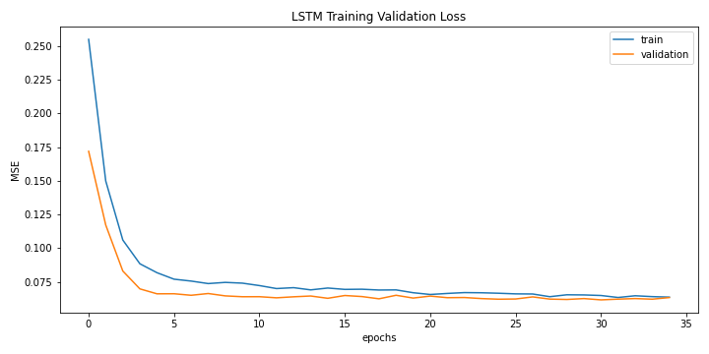
Validation data percentage in training : 30%
Optimal Hyperparameters :
Epochs : 35
Batch size : 14
Neurons : 32
Layers : 2
Adam optimizer with learning rate : 0.0005
Dropout : 0.05
Metric used : Mean Squared Error(MSE)
RMSE : 495.86
MAE : 361.8
R- Squared : 0.87
Figure 10: LSTM model convergence for training and validation data.

Slide 16
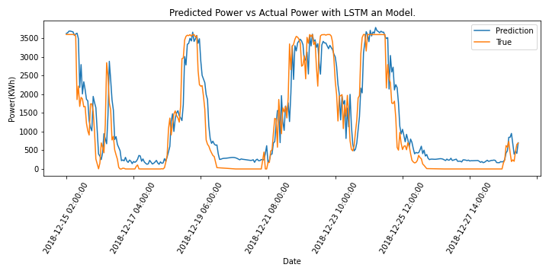
Figure 11: LSTM model predicting on two weeks of unseen data.

Slide 17
Assumptions & Limitations
Wind turbine fully functional after filtering data.
SCADA device providing accurate data throughout the year.
Only a years worth of data used.
Additional wind data in the same area could benefit the model.

Slide 18
Conclusion
Data was resampled for hourly inverals with additional features added to the data set (X_compoenent, y_compoenent, T_1).
Any signs of maintenance were removed from the dataset.
Adfuller test proved stationairty in all time series features.
Turbine greatest power loss in NE, NNE direction.
LV Power feature co-integrated with all other features.
LSTM showed to accrutely model data identifying peaks and lows in unseen test data with RMSE : 495.86, MAE : 361.8, R-Squared : 0.87.
Future Work
Predicting which direction the wind turbine should turn to prevent power loss.
Obtaining relevent data (wind data, years prior to 2018) to improve model.

Slide 19
Thank you !!
By : Amit Bharadwa
Email: amit_123@hotmail.co.uk
Linkdin: https://www.linkedin.com/in/amit-bharadwa123/
Github: https://github.com/Amitdb123/Forecasting-Wind-Turbine-Power-

